Slide 1




Automated Identification of Rockfish and Habitats from SeaBED Imagery
Nick Loomis (MIT-WHOI JP)
Notes:
Todo: check the title, match against the seminar schedule; add logos

Slide 2
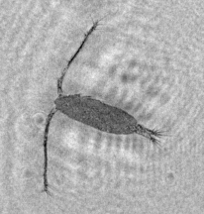
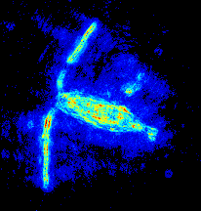
Thesis Topics
Auto ID of rockfish and habitats
Design of a holographic system for in situ microscale imaging
Algorithms and methods for extracting images from real-world holograms + applications

Slide 3
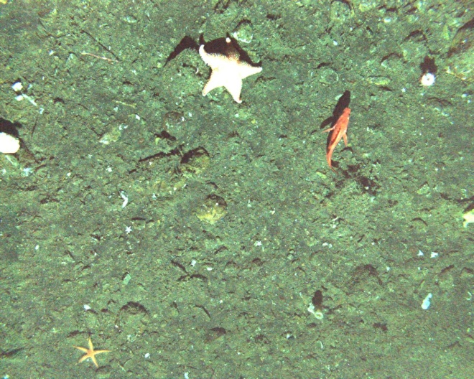
Immediate Goal
Left: image from SeaBED
Right: habitat classification, belief strength
Left overlay: highlight box around rockfish with belief strength
Rubble
Rubble
Rubble
Rubble
Rubble
Rubble
Rubble
Rubble
Sand
Rubble
Rubble
Rubble
SeaBED optical image

Slide 4
Secondary Goals
Introduce techniques:
Bag-of-words texture recognition
Boosting, esp. for detection
GPU processing

Slide 5
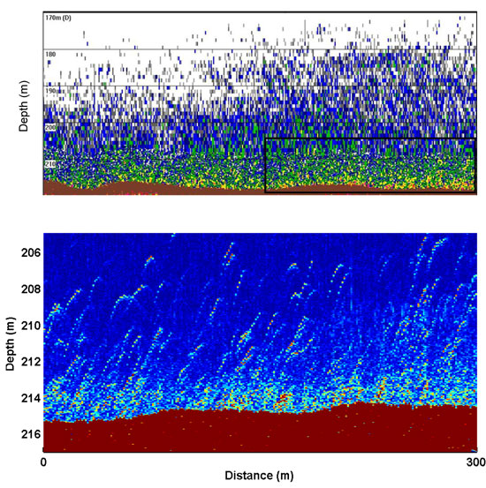
Why Imagery?
Resolution (Detail)
Stanton T K et al. ICES J. Mar. Sci. 2010
SeaBED optical image
Direct (nets, hooks, observers)
Traditional
Imaging
Broadband sonar (fish)
Sonar
Area or Volume

Slide 6
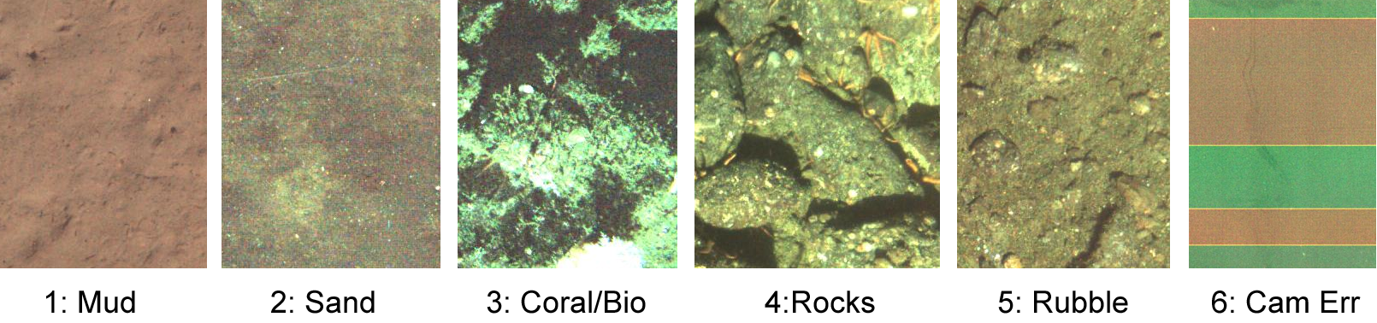
Goal 1: Habitat Classification

Slide 7
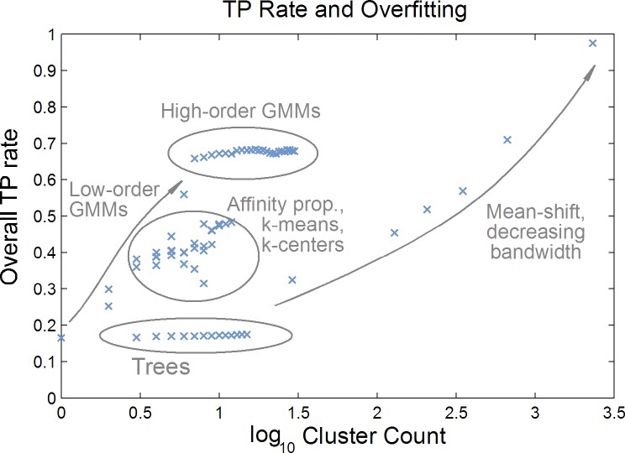
Unsupervised Clustering

Slide 8
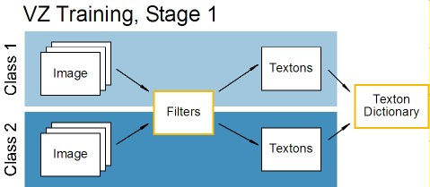
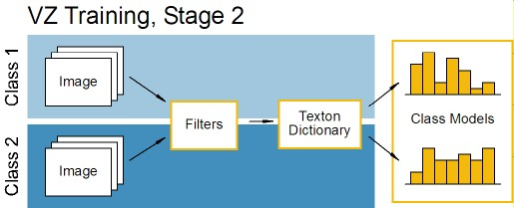
Varma-Zisserman Training
a.k.a, “Bag-of-Words”

Slide 9
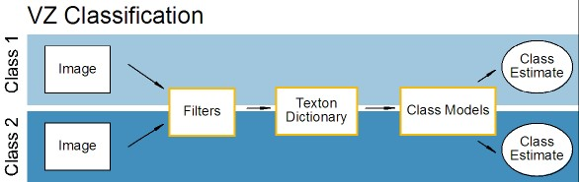
Varma-Zisserman Classification
A way of describing image content
Alternate idea: extract small image patches directly from the training images
Use k-means to select the representative patches (textons)

Slide 10
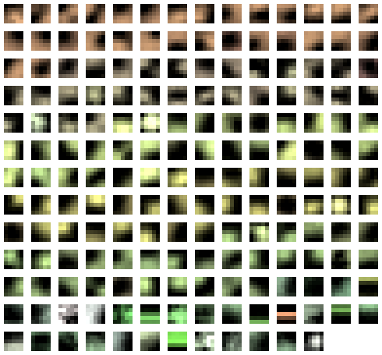
Patches
k = 30 textons per class, n = 5 pixels

Slide 11
Patch Intuition
Direct model of image content
Filter responses are projections
Maintains higher dimensionality (kernel-like)
Contain similar information as gradients

Slide 12
Eigenpatches
Patch dimensionality: n²+3
For small n: easily generate redundant patches
For large n: extremely high dimensionality
Decompose patches into a shared eigenspace before creating models
n: number of pixels per side
+3: mean color vector over patch

Slide 13
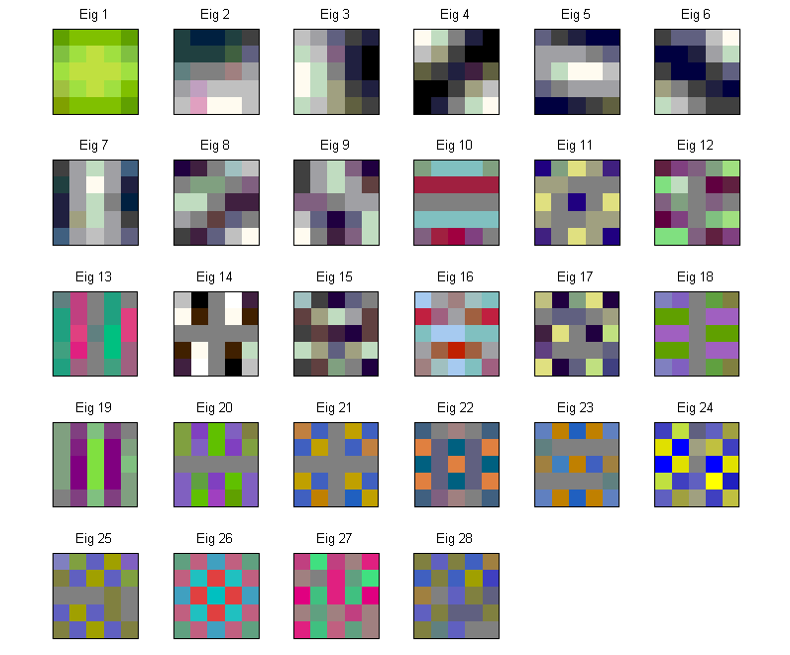
Eigenpatches
1: highest energy
28: lowest energy
Eigenvalue sign ambiguity leads to inverted colors in some cases

Slide 14
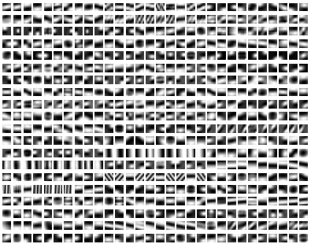
Patches from VZ
Note: training set includes a variety of natural and man-made textures

Slide 15
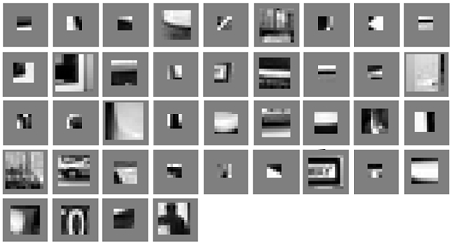
Patches from Torralba
Note: Patches selected for detecting multiple classes of man-made objects using boosting

Slide 16
Number of Class Models
Each training image generates a model
Single model per class: aggregate the models for all training images in the same class
Multiple models per class: select representative models
Affinity propagation to guarantee class membership
Akaike-like criterion for selecting appropriate number of models

Slide 17
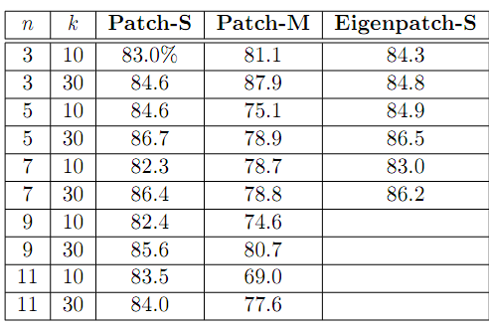
Initial Results (Overall TP Rate)
n: number of pixels per patch side
k: number of textons per class
-S: single model per class
-M: multiple models per class
In general: 80-85%.

Slide 18
Independent Components Analysis
Idea: increase discriminability by better distributing energy through all the components
y
y’
x
x’
p(x,y): joint distribution
p(x’,y’) = p(x’)p(y’): independent

Slide 19
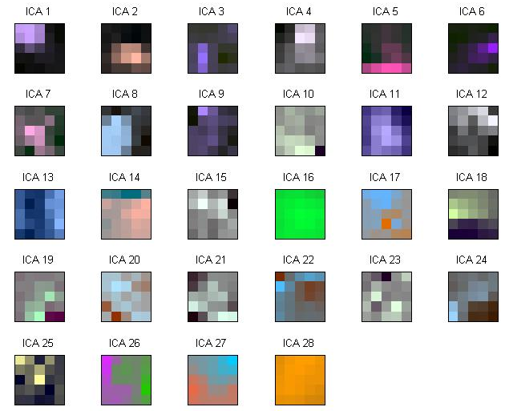
ICA Patches
Note: same dimensionality reduction as eigenpatches
Less intuitive; blob-like; relation to phase-space filters

Slide 20
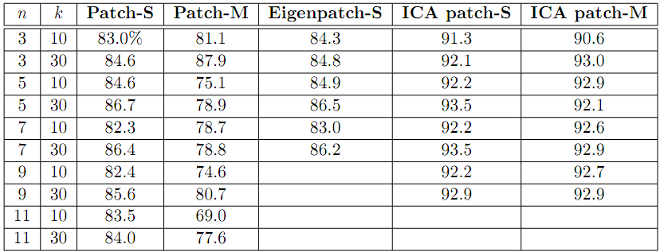
Patch Comparisons
ICA: around 8% better than patches
n: number of pixels per patch side
k: number of textons per class
-S: single model per class
-M: multiple models per class

Slide 21
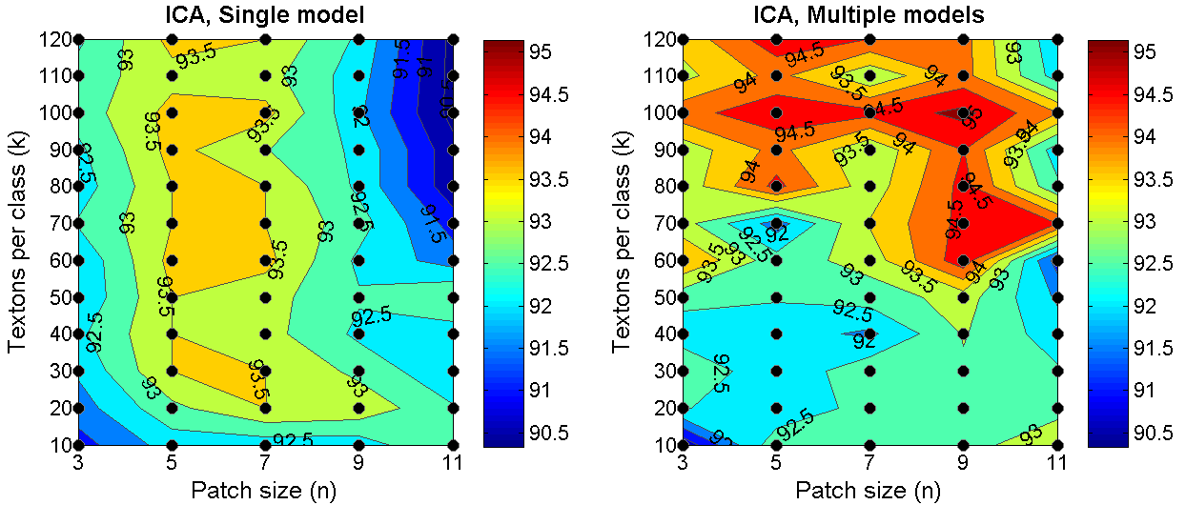
ICA Parameter Space
Plot: overall TP rate
“Enough” textons
“Enough” textons
Plateau of “big enough”
Plateau of “big enough”
Hint: ICA-M has 1-4 models per class, on average
Notes:
Regions are almost a “Little Red Riding Hood” phenomenon

Slide 22
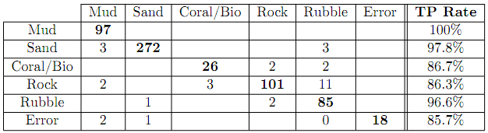
Best Overall Confusion Matrix
Estimated class
True class
94.8% Overall TP
Subtle visual differences (error is less harmful)
n=9x9 pixels
k=60 textons per class
ICA-M method
Note: limited (n,k) for speed and memory
Notes:
TODO: fix the numbers – there’s a better classifier than this. Also, make the table look better.

Slide 23
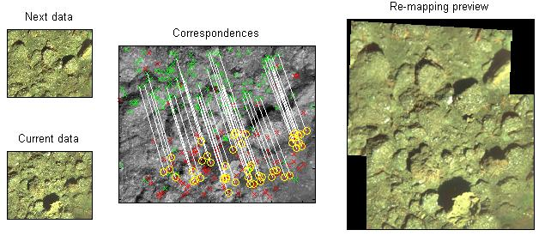
Area Coverage

Slide 24
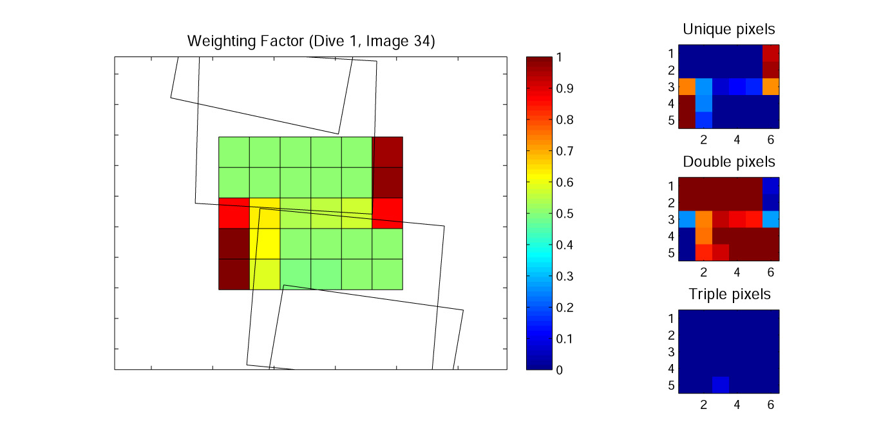
Area Coverage

Slide 25
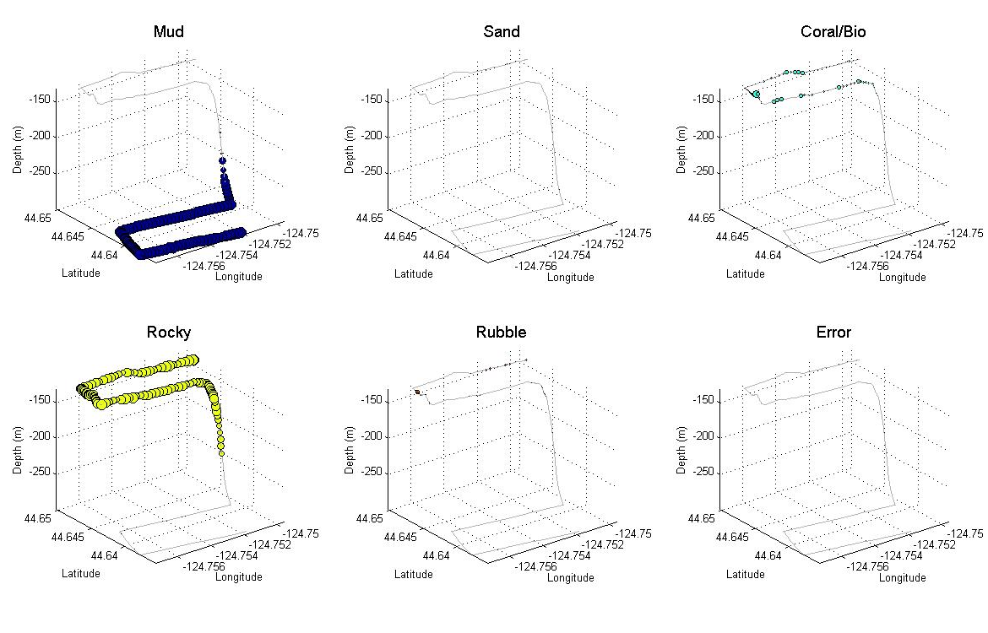
Area Coverage
Daisy dive example, 3D w classification

Slide 26
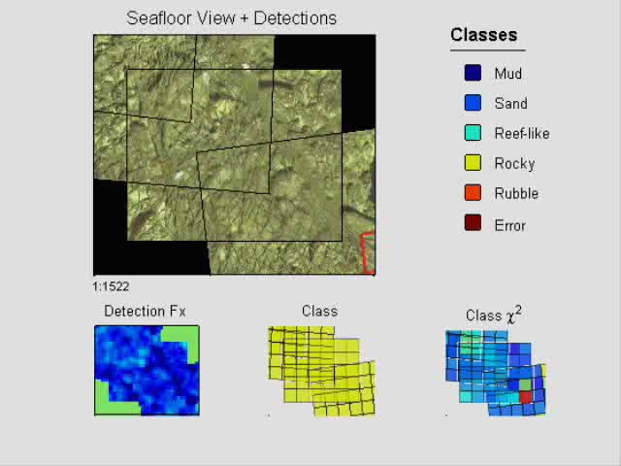
Area Coverage

Slide 27
Limits for Bag-of-Words Models
Each pixel is independent: ignores spatial information
Random fields, info from neighboring frames for future intrepid engineering students
Classification limited to expert’s labels
Detect images that match models poorly, present as new textures
Requires training data (post-processing inherent)
In situ use limited to areas with similar habitats as training data; resurveying earlier areas

Slide 28
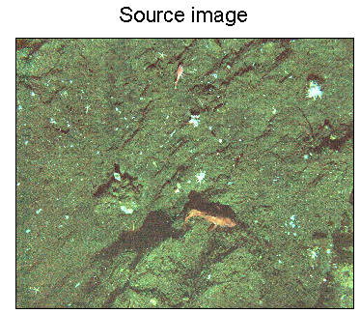
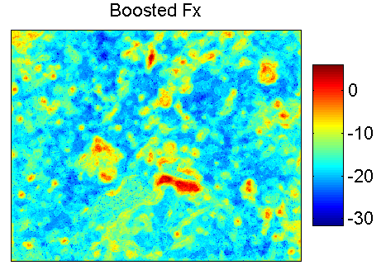
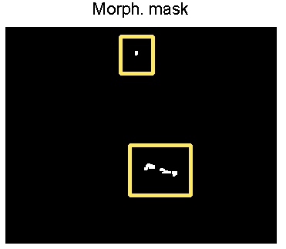
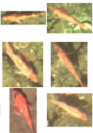
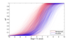
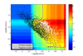
Goal 2: Rockfish Detection
Multi-stage detector-classifier
Filter-based feature vector
Detected rockfish (w. good outline/shape, belief strength)
Morphological mask (regions)
Combined shape and Fx CDF features
Chan-Vese mask and fast shape features

Slide 29
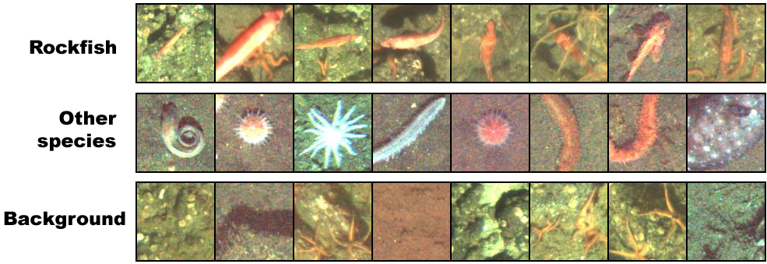
Challenges

Slide 30
Boosting Overview
Use linear combination of weak classifiers (50% or better) to make a single strong classifier
Features can have mixed scales
2001: used for an amazing fast and accurate face detector (with simple features)
Currently used for face detection in point-n-shoot cameras

Slide 31
Boosting Process
Goal: combine weak classifiers to create a complex, strong decision boundary

Slide 32
First stump
NB: the demo here uses 1D decision stumps!

Slide 33
Re-weight based on error

Slide 34
Add a stump, re-weight

Slide 35
Repeat…

Slide 36
…to create a complex boundary…

Slide 37
…and combine into one classifier.
Red: “true” boundary
Black: AdaBoost boundary

Slide 38
Stage 1: Candidate Regions
Best features
Color: cos(Hue), sin(Hue), Saturation, Value
Texture: monogenic filters
Statistics of the local pixel neighborhood
Train boosted classifier
Classify as rockfish pixel or non-rockfish pixel, group using simple morphological ops

Slide 39
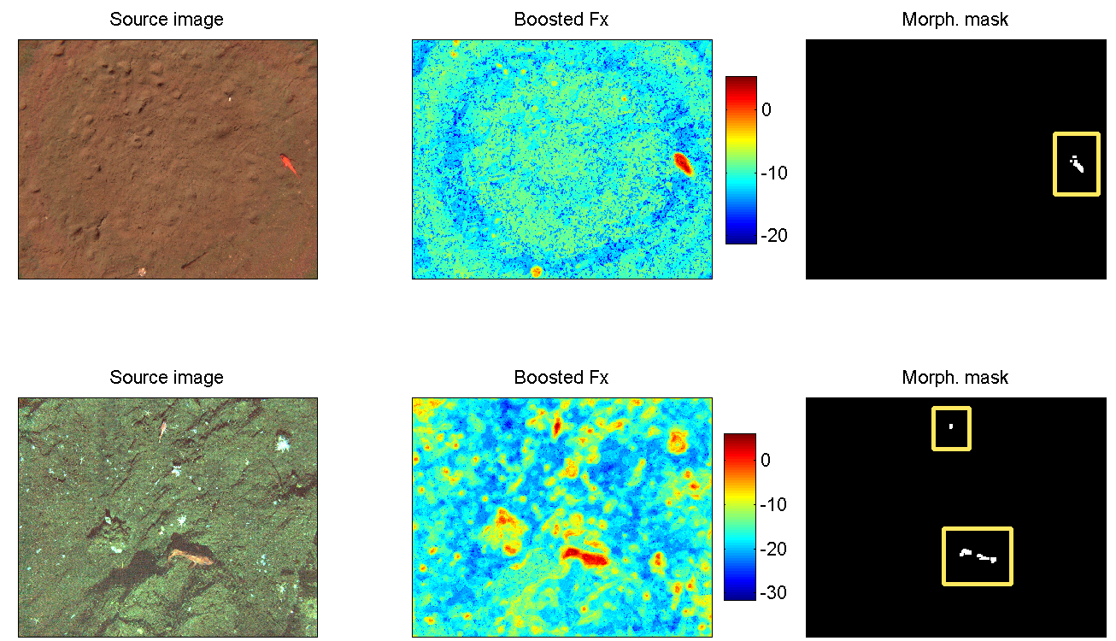
Region Detection Examples

Slide 40
Stage 2: Pruning With Shape
Chan-Vese (CV) region masks using Saturation, Value color data
Compute major, minor axes
Log(axes) includes area (sum), perimeter (area relation), eccentricity (for high ecc.)

Slide 41
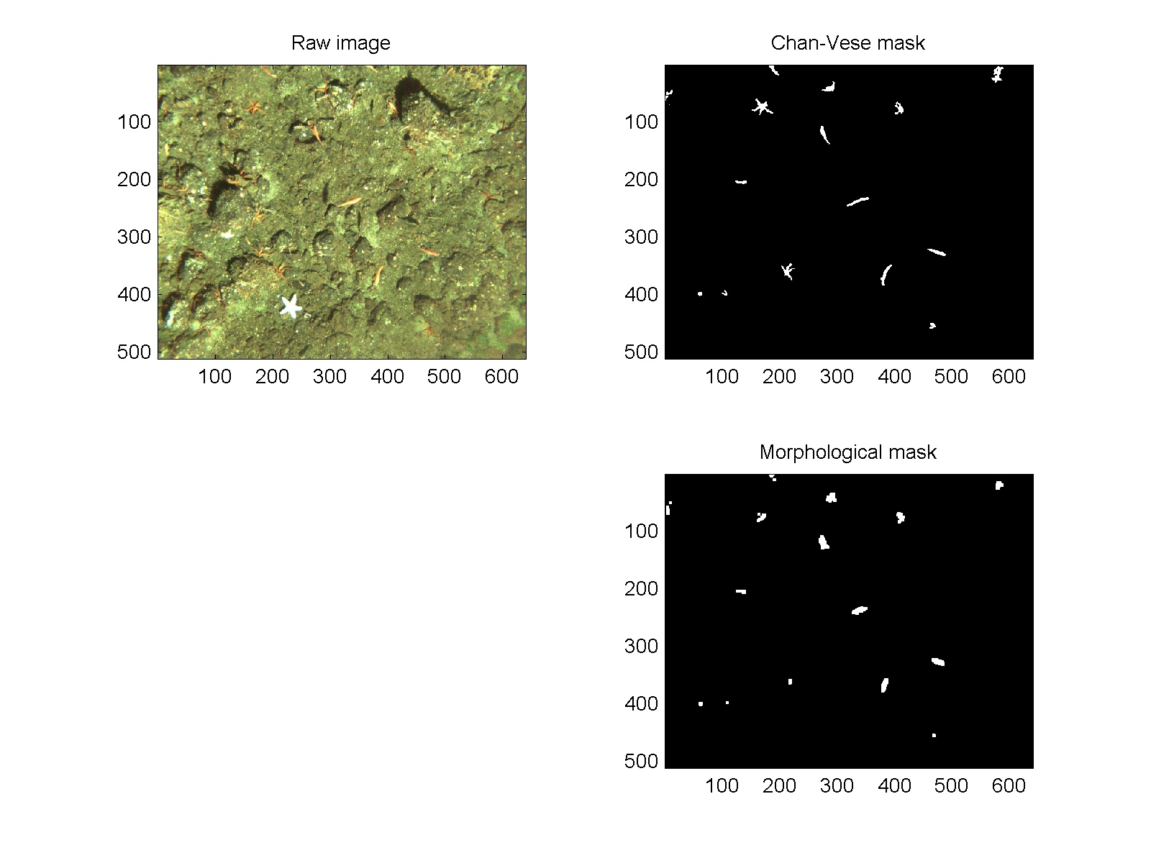
Regions from Chan-Vese

Slide 42
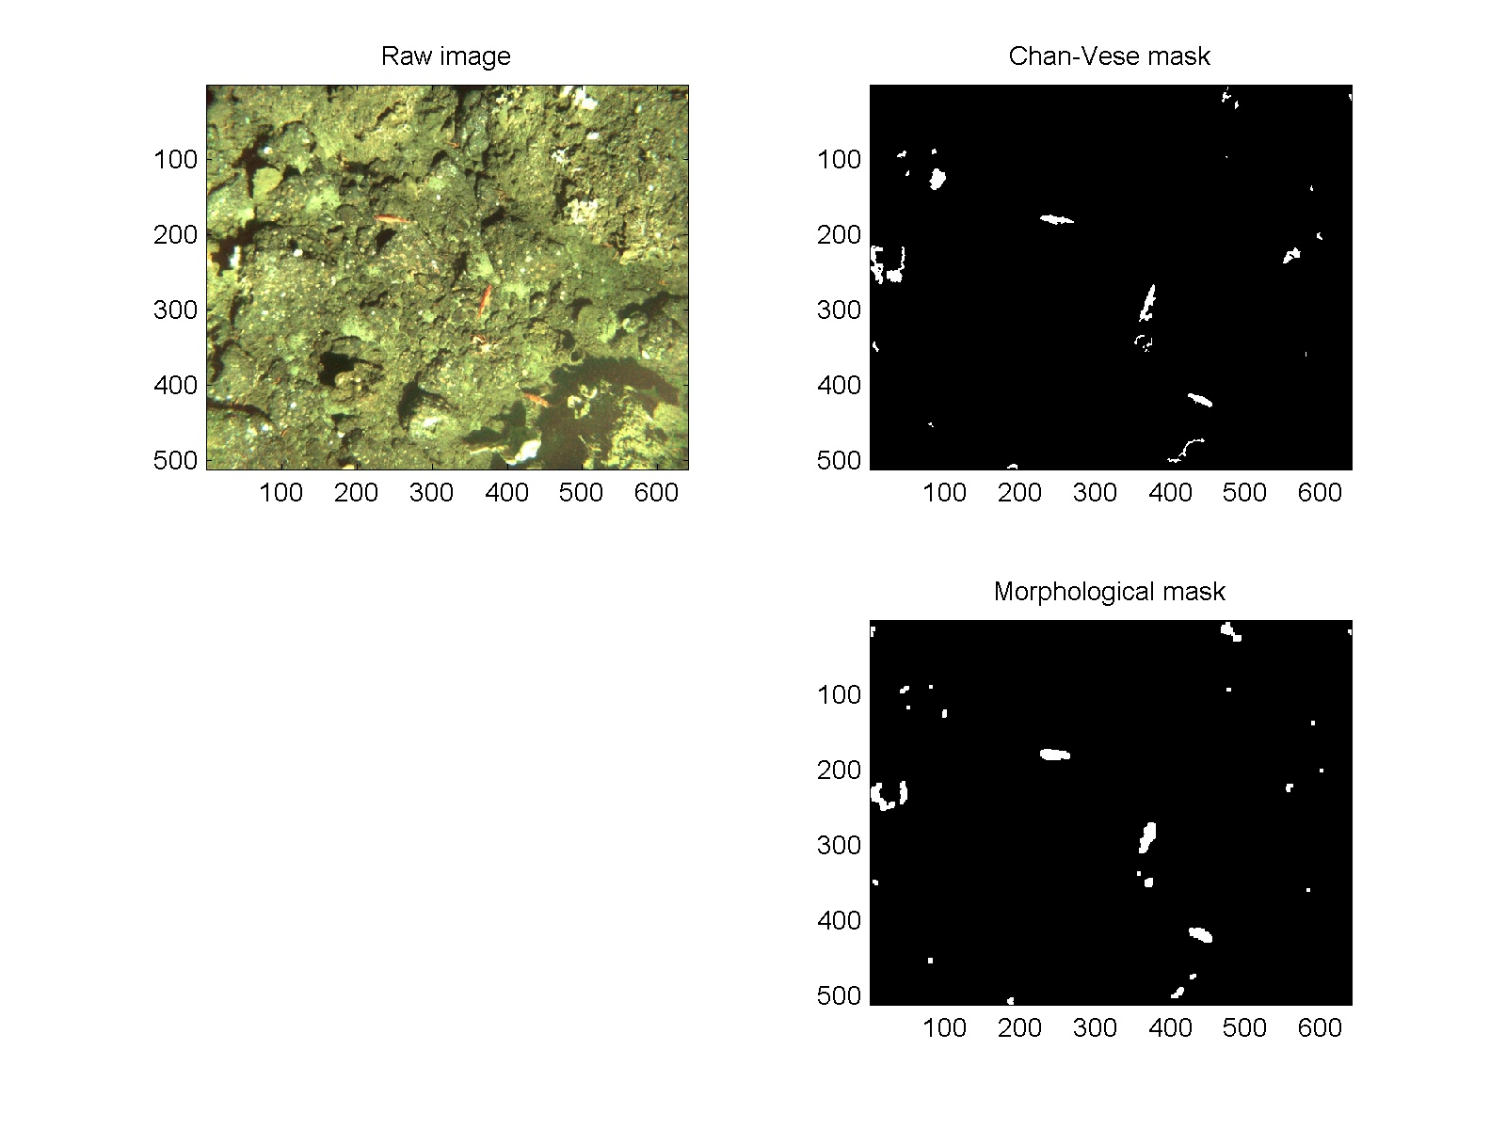
Regions from Chan-Vese

Slide 43
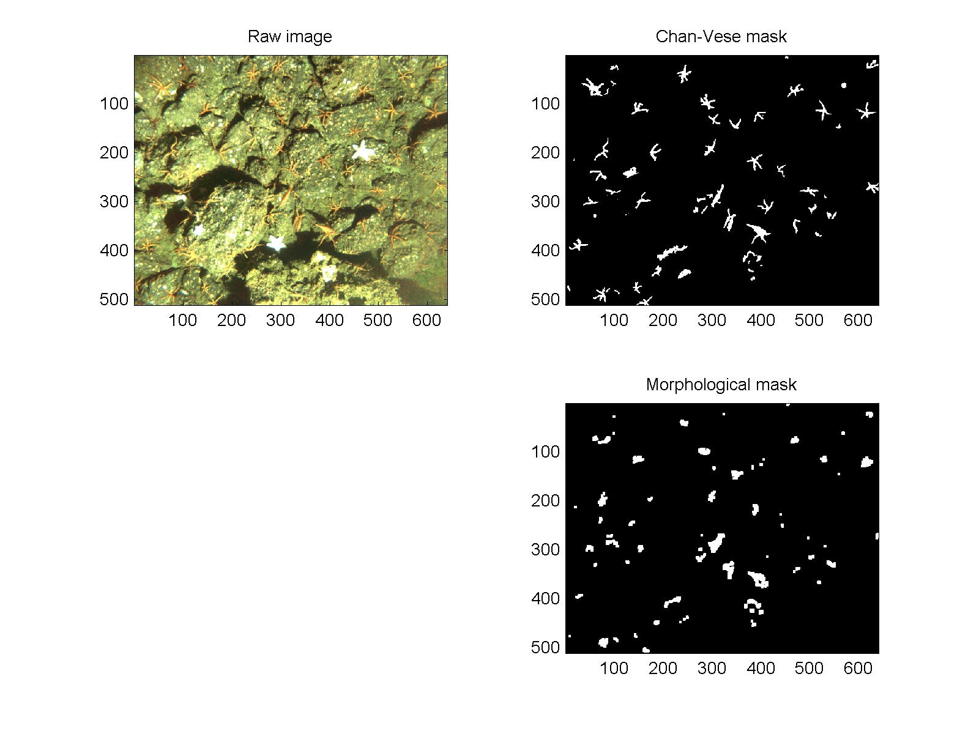
Regions from Chan-Vese

Slide 44

Adjusted Size-based Decision Region
Color: boosting Fx values

Slide 45
Stage 3: Shape and Region-Belief
Shape: Zernike moments (with CV mask)
Region-based belief
Stage 1 had local color, texture information (stored in boosting value)
Stage 2 had improved region information
Get a distribution over the object region

Slide 46

Region Belief CDF

Slide 47
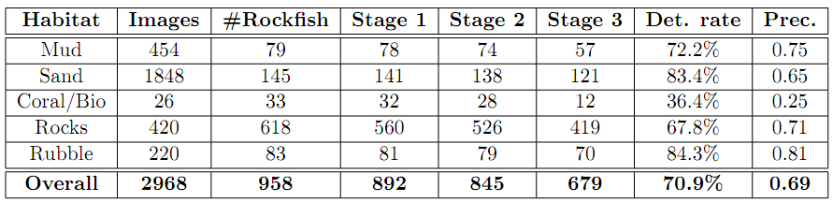
Detection Results (2)
Zernike shape and Fx CDFs
Fast shape from Chan-Vese
Regions from boosting, morph.

Slide 48
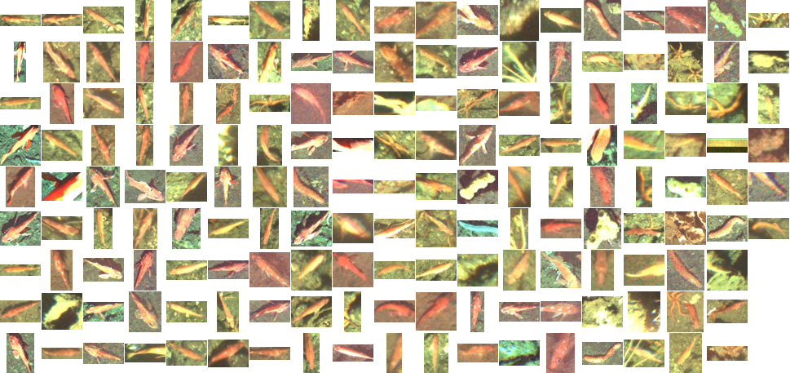
Detection Results (1)
Increasing confidence
Decreasing confidence

Slide 49
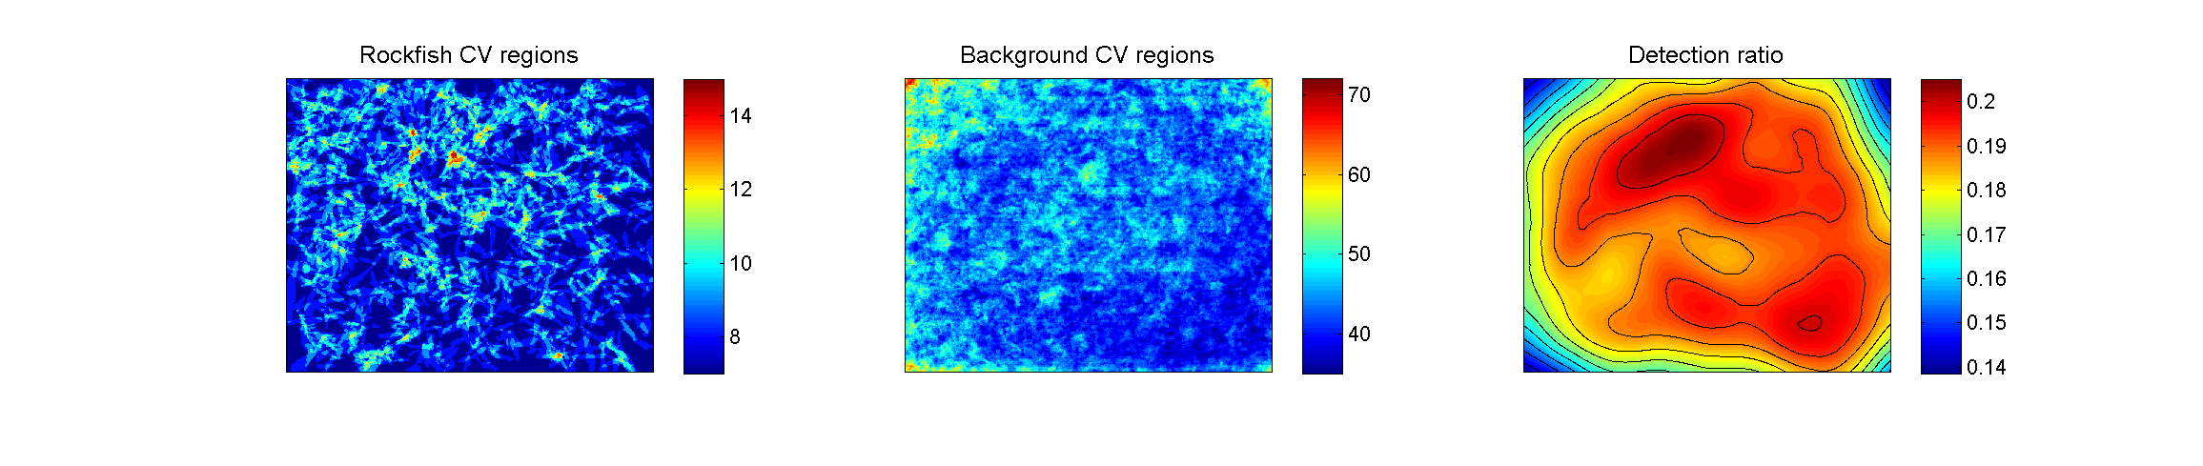
Sensitivity and Avoidance

Slide 50
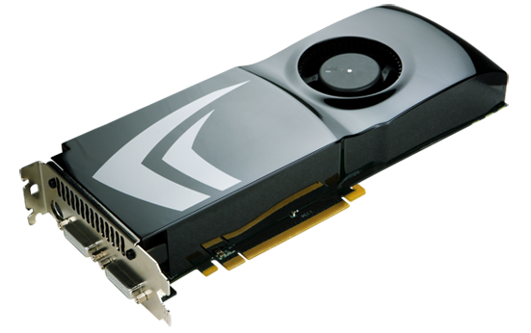
Fast Features on GPUs
Graphics Processing Units
Massively parallel devices, commercially available for less than the cost of tonight’s dinner ($100-$500, 100-400 multi-processors per GPU card)
Reduced instruction set: optimized for speed
Typical speedup of 5-50x
Large and growing user base

Slide 51
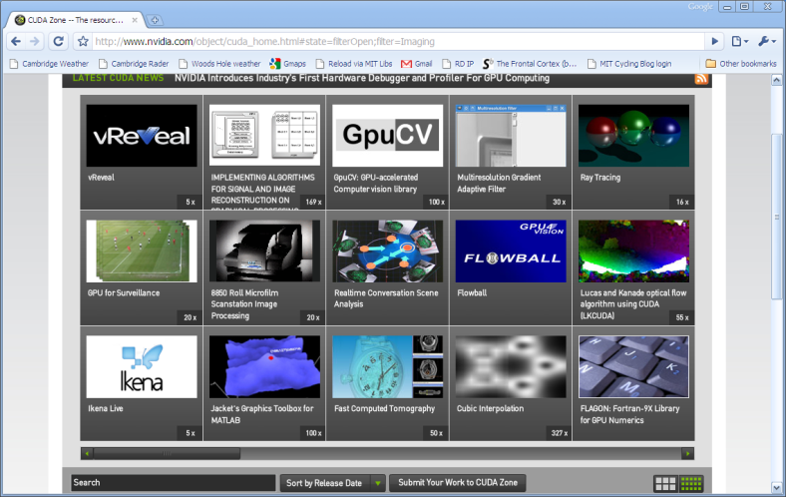
Libraries/Languages
CUDA for NVidia, Stream from ATI: C/C++
OpenCL from Apple (common interface)
OpenGPU, GpuCV = OpenCV libraries
Matlab integration via MEX/C and latest vers.
Already implemented: BLAS, FFTW, DPP, some LAPACK
Other libraries from the user base
Moral: Computational speed is no longer a restriction.

Slide 52
Feature computation
Steps:
1) Write basic kernels, high-level data handling
2) Transfer image to GPU
3) Run kernels in parallel: 100-400 computations simultaneously
4) Retrieve results back to CPU
VZ: see 40x speedup
Boosting features: 8x speedup (non-optimized)
Boosting can be implemented directly on GPU

Slide 53
Goal.
Left: image from SeaBED
Right: habitat classification, belief strength
Left overlay: highlight box around rockfish with belief strength
Rubble
Rubble
Rubble
Rubble
Rubble
Rubble
Rubble
Rubble
Sand
Rubble
Rubble
Rubble
SeaBED optical image

Slide 54
Backups

Slide 55
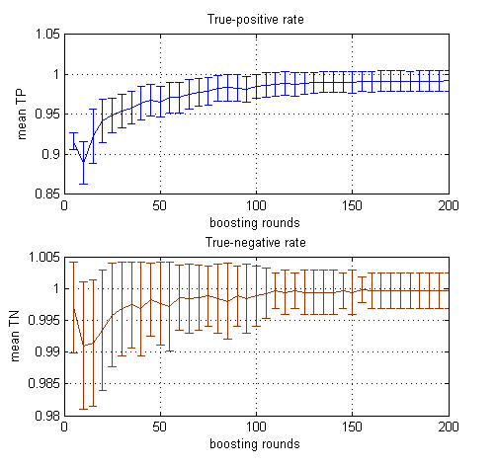
Stage 1 Training Rates

Slide 56
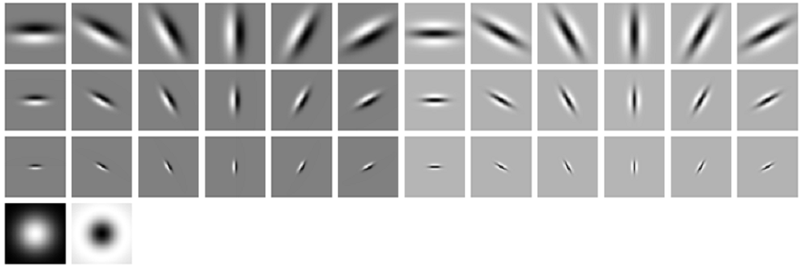
MR8 Filterbank
Take Max Response over all orientations at a particular scale
Bar, edge, Gaussian, LoG filters

